Slide 1
ASANA

Slide 2
Asana Basics
What is Asana?
Project Management tool used to create project timeline, track due dates and tasks, and collaborate with clients.
Which clients should get a project timeline in Asana?
When projects involve copywriting and/ or design.
When do I create an Asana schedule?
When a confirmed drop date for an upcoming project is known. Update after planning call.
Why should I use Asana?
To keep clients on track by assigning them due dates.
To keep yourself on track, especially when you have multiple projects going on at the same time.

Slide 3
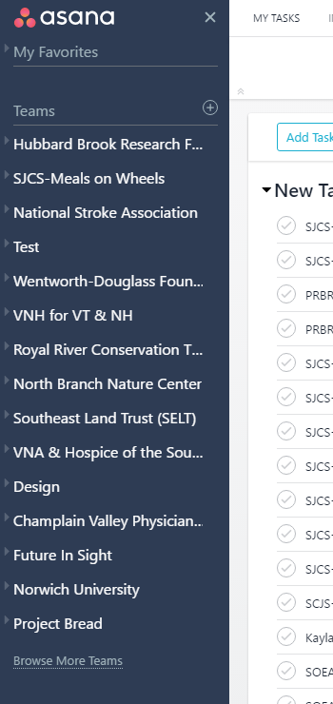
Asana “Teams”
Client names are our “Teams” in Asana (e.g. Project Bread, SJCS- Meals on Wheels, etc.)
These will be located on the left hand side of the page.
Established clients may already have a team created. To check, you will click “Browse More Teams” on the bottom left panel. A list of teams will open up and you click “Join.”

Slide 4
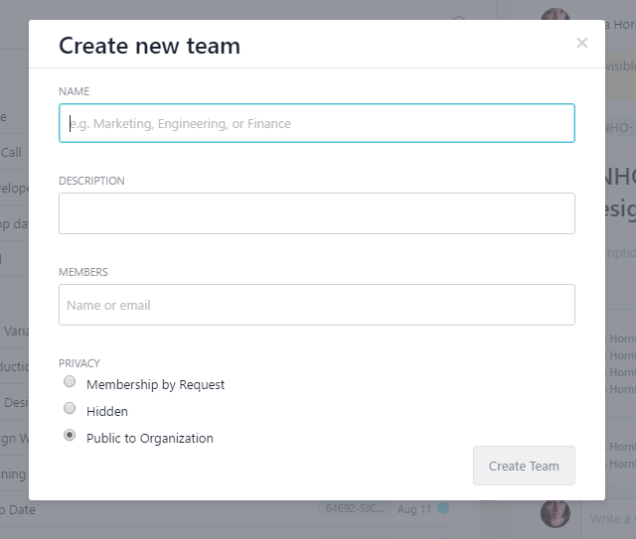
Creating a New Team
New clients will need a new team created. Next to “Teams” heading, click on the “+” button, as shown in picture.
Client name will be team name.
Add the client Sales Rep to “Members” section by typing in their name. It should automatically populate.
Add clients by typing in their email address.
Make a selection for privacy settings: Public to Organization
Click “Create Team” box

Slide 5
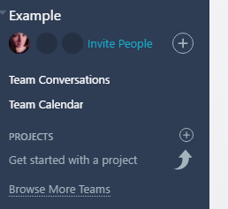
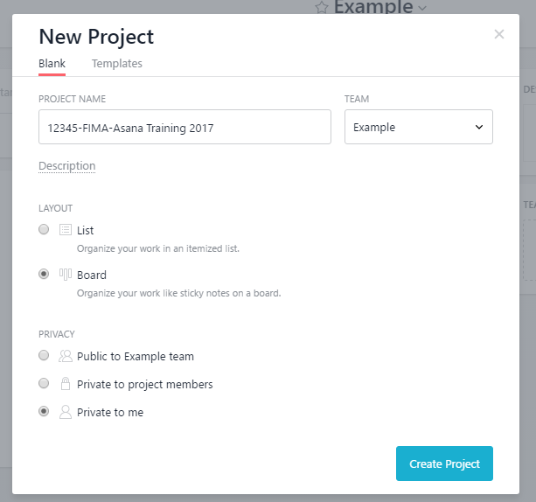
Creating a New Project
Under your new team, click the “+” next to “Project.”
Enter your project name.
(WO# - Customer Code- Detailed Project Name)
Choose a layout (List or Board)
Choose a privacy setting.
I recommend choosing “Private to Me” until you’ve finished inputting & assigning tasks.
Click “Create Project.”

Slide 6
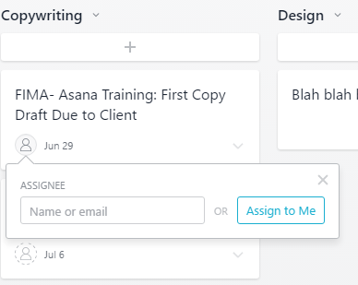
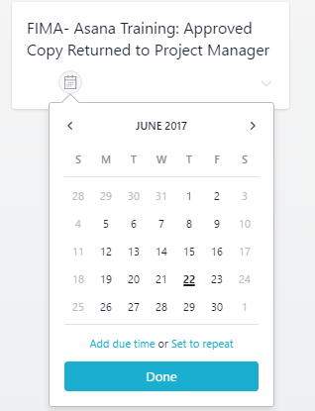
Creating Tasks & Assigning Due Dates
To add a subtask (e.g. Planning Call, Drop Date, etc.) click on the “+” directly underneath the milestone task
Type in your task name
(Customer Code- Project Name: Task)
To assign the task, click on the circle in the task box with a person symbol. Start typing who the task will be assigned to (Darin, client name, etc.) or select “Assign to Me”
To assign due date, click on the circle with a calendar. Pick the date you want it due
If you ever need to change the date on a task, just click on the date & select a new one

Slide 7
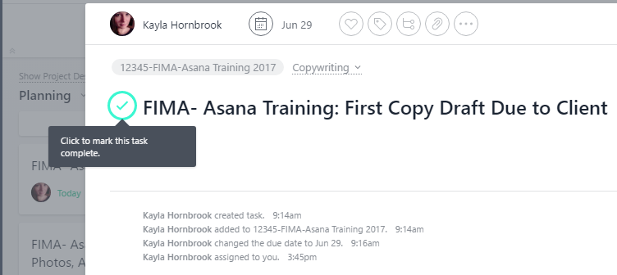
Completing A Task
Click on the task you want to mark complete
Next to task name there will be a circle with a checkmark inside. Click it. Task is now complete

Slide 8
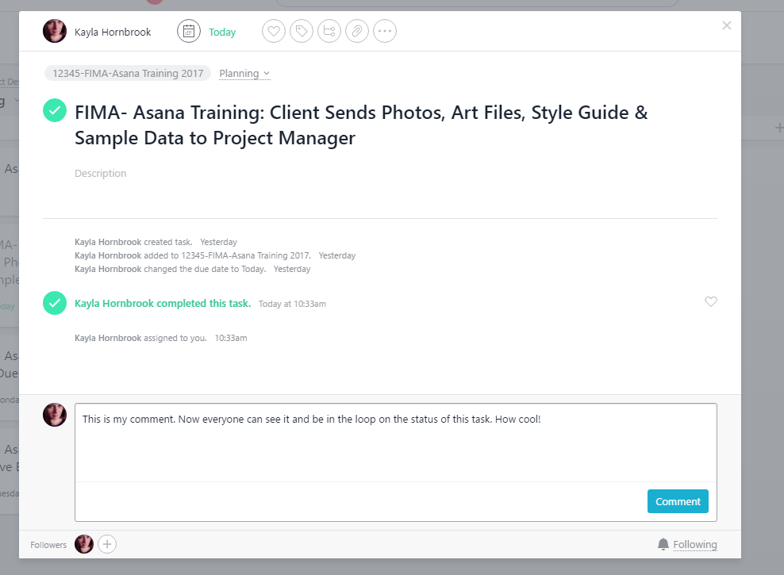
Comment on a Task
If you need to comment on a task to explain a push of the due date, status of the task, etc… click on the task you need to make a comment on.
At the bottom of the pop up is a text box. Type in your comment & hit the “comment” button to submit.

Slide 9

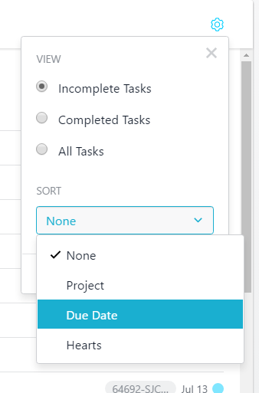
Viewing All Tasks Assigned to You
To view all tasks assigned to you, click “My Tasks” located near top left of page, just right of Asana logo
Sort tasks by clicking the gear symbol on the right side of the page.
You can sort by project, due date, or hearts (if you have one)
It is recommended you sort by due date

Slide 10
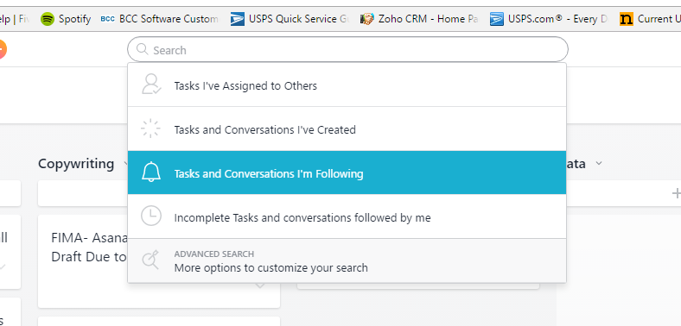
Viewing All Tasks for a Project
Click on the search box at the top of the screen
A drop down should appear
Click on “Tasks and Conversations I’m Following”

Slide 11
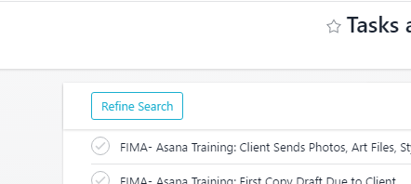
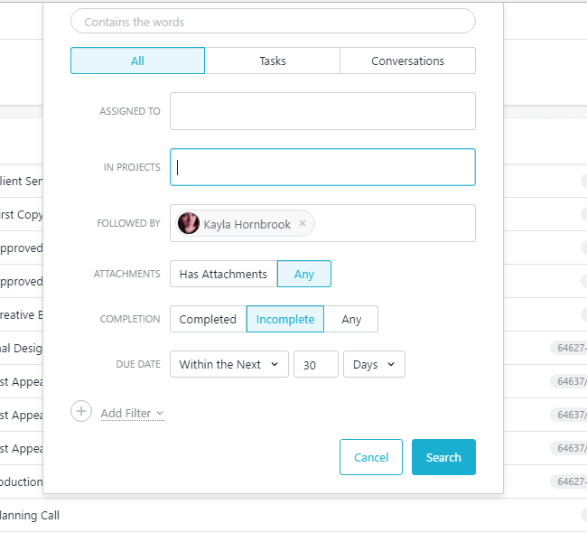
Viewing All Tasks for a Project, cont’d
Click “Refine Search” on top left of list that populates
Under “Completion,” select “Incomplete”
Under “Due Date,” select “Within the Next 30 days” (since most projects are approximately 30 days start to finish
Click the “Search” button
Just like in viewing “My Tasks,” you’ll want to hit the gear symbol on the right and sort by due date

